Slide 1
Topic 8 Team Building
Overview and Concepts

Slide 2
The Expedition section involves participants working together as a team in order to complete the expedition. Teambuilding should permeate all expedition training and can be enhanced through team-building exercises and regular reviews so that when the group sets out on the qualifying expedition, participants are able to work together as an effective and cohesive unit.

Slide 3
Welcome to the Orb Labyrinth
At the end of each successful team challenge each team will be given an orb (ping pong ball sprayed yellow). Note they will not receive one unless they have successfully completed the challenge. The winning team is the one with the most orbs at the end of the weekend! You could either give them a time frame for each challenge or they could take as long as they like on them but the longer it takes the less orbs they will retrieve.

Slide 4
There are many Challenges ahead of you, some may not make it out alive!!!
Make a map up of the team building area, with all challenges numbered on it, try to make sure that no one challenge can be seen from any others.
1
5
4
7
11
10
12
3
8
6
9
2

Slide 5
Equipment: Blind Folds and Paper with animal names on them.
Aim: To put everyone into there teams using a challenge.
Method:
1. Ask everyone to sit in a circle, facing outward. You will stand on the inside of the circle.
2. Walk around the circle and pass out the animal names. Choose as many animal names as you wish teams. Teams of 8 are quite good.
Ask everyone to read there animal name and keep it secret, tell the young people how many people are in each team.
They now have to take ten steps away from the circle, and put there blindfolds on.
They must now find the other animals in there groups, they should do this by making animal noises.
These are the teams which you will use, for the rest of the weekend.
Variations: You can do this with any type of animal or birds, anything that makes a noise. Or you could use Character’s and phrases.
Safety Considerations: People should be told not to walk to quickly, and everyone should keep there hands out in front of them. Also have a whistle with you and if you see a collision blow it to stop everyone.

Slide 6
Challenge 1: Egg and Spoon Race
Equipment: Cones, ropes to make obstacle course. Eggs, Blindfolds.
Aim: To get as many eggs as possible to the finish line. Each team member must do this once successfully in order to achieve your orb.
Method: One person carries the egg and spoon and the other person guides them. Cones are set up to walk around and hurdles or ropes which must be stepped over, crawled under etc. Each team member must have a shot of both roles.
Variations: This could be done with tray and cups of water instead.
Safety Considerations- Do this on grass, make sure players understand that there is no time constraint on this so they can take there time.
Start
Over
Under
Over
Under
Over
Finish

Slide 7
Challenge 2: Toxic Waste
Start
Start
Equipment: Tires for Islands, Wooden Planks for Bridges, (2 per group)
Aim: To get from start to finish without falling in the toxic waste, if you do then you must go back to the start. Your bridges must be set between positive and negative islands. If you drop a plank into the toxic waste you will loose it.
Variations: Start of with the entire group trying to do it with all four planks. Then separate into two teams with two planks each, and do this as a race. Then to finish off do as one team with three planks then two.
Safety Considerations: You are not allowed to through the planks, if done then start again. You must carefully pass from team player to team player
-
+
-
+
-
-
+
-
+
-
-
+
-
+
-
-
+
-
+
-
-
+
-
+
-
Finish
Finish
Islands
Toxic Waste

Slide 8
Challenge 3: Minefield
Start
Start
Equipment: Bombs (Cones), Treasure (different coloured balls), Blind Folds.
Aim: To collect treasure valuing 500 thistles. Each coloured treasure has a different worth. When you have collected over 500 thistles before the other team and put them in your finish bucket.
Method: Two people in each team put on blind folds and must collect treasure without hitting the bombs (black) if they hit a bomb then they drop all there treasure and must start back at the beginning. They must get the treasure into the finish bucket at the end but they are only allowed to carry one piece of treasure at a time.
Variations: Complete within time restriction.
Safety Considerations: People must travel slowly and any objects used must be soft, in case fallen on.
finish
finish

Slide 9
Challenge 4: Tarptastic
Equipment: Tarpaulin about 10 foot square, 16 holes cut in at random (bigger than tennis ball). Centre of tarp is marked with a cross. Tennis Ball. Half the holes should be red and half white.
Aim: The team must get all the white tennis balls into the holes without getting the red ones.
Method:
Team members line up on each side of the tarp.
The ball is placed on the cross
Teams move tarp around to score
Tarp may not be raised higher than shoulders.
Ball may not be BOUNCED off tarp, or rolled over the edges.
Teams can use their bodies to stop ball falling off their edge, but not hands.
If ball falls over the edge, re-start it in the middle.
Ref’s decision is final.
If a red ball falls through the whole then all white balls are placed back on the tarp and the game effectively starts again.
Variation: This can be played as a team game with one team being white and the other being red.
Safety Consideration: Do not lift tarp above shoulders. If referee blows whistle

Slide 10
Challenge 5: The Tower of Hanoi
3
5
2
1
4
Equipment: 5 numbered tyres, 3 poles
Aim: The Tower of Hanoi puzzle was invented by the French mathematician Edouard Lucas in 1883. Your task is to transfer the entire tower from the left pole, to the one on the right, moving only one tyre at a time and never placing a larger numbered tyre onto a smaller numbered one.
Method:
You are only allowed to move one tyre at a time.
You are not allowed to place tyres on the ground outside the poles.
I am not allowed to answer questions, but I may read these instructions to you once more.
You may use the centre pole.
There must only be one tyre outside the poles at any time.
moving only one tyre at a time and never placing a larger numbered tyre onto a smaller numbered one.
You may not place tyres down outside the poles.
Safety considerations: Every member of the team must help move each tyre.

Slide 11
Challenge 6: Memory Lane
start
Equipment: Peg out a square grid or spray it (use waterbased). Each square should be big enough to stand in. Plan a secret route through the grid. This is just an example.
Aim: To get the whole team to follow the secret route from the start to the finish in as little time as possible by remembering the right steps taken by the predecessor.
Method:
1. Team stand in a line, behind the start, person 1 steps into the grid, if they step into the correct square (yellow) then they can continue, if they step into any other then they must go to the back.
2. Then the next team member goes, using the parts that the last person got correct.
Safety Considerations: If pegging out grid ensure that it is all pegged down securely and that it will not be a trip hazard.
finish

Slide 12
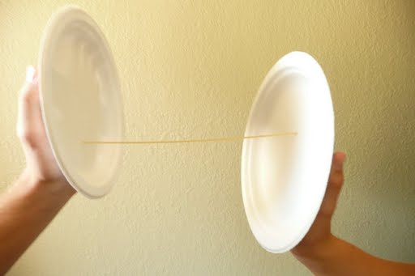
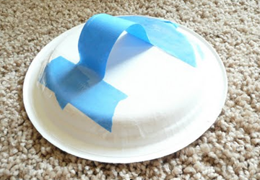
Challenge 7: Pasta Masta
Equipment: One paper plate for each team member, Masking tape, A package of dry spaghetti. Use the masking tape to create a handle of sorts on the back side of each paper plate to create a "hand held device". Place the pasta and the hand held devices on a table.
Aim: To transport Pasta from start table to finish bucket without breaking it.
Method:
You must move as much pasta as possible to the bucket.
Only one team member is allowed to touch the pasta, but must stay at the start.
The remaining team members will each have a hand held device.
Work in pairs to move the pasta to the bucket by holding the pasta end to end between two hand-held devices. Each pair may only move one piece of spaghetti at a time.
If the pasta breaks, come back for more! You will receive one point for each piece of pasta in the bucket at the end of the allotted time.
You must make ten points in order to make an orb, every time you break a piece of pasta then you loose a point.
Finish
Start

Slide 13
Challenge 8:Blindfold Tent
Equipment: Tent and blindfolds
Aim: For the team of people to pitch a tent whilst blindfolded.
Method:
Ask the team to pitch the tent they can use directions if they want without blindfolds as team.
They must now come up with a plan of how they will do it blindfolded, they may pitch the tent one more time without blindfolds if they wish.
The team will only get there orb once the task is achieved using all members of the team, and under the inspection.

Slide 14
Challenge 9: Sheep and Shepherd
Equipment: Large open grass space free from obstructions or, hazards. Rope laid out on the ground to mark out the sheep pen, blindfolds.
Aim: The shepherd has to get the sheep in the pen.
Method:
Select one team member to be the shepherd. Everyone else will take the role of sheep.
The shepherd is to stay in one place in the centre of the field and may only clap or whistle.
The sheep wear blindfolds and are scattered around the field and may only make sheep noises.
Before putting blindfolds in place give the team time to plan how they are going to use these sounds to achieve the task.

Slide 15
Challenge 10: Bomb
Fuel Rod
Equipment: 2 pieces of rope, area marked out as the reactor core and a cylindrical item which can be used as a fuel rod.
Aim: To remove the bomb from the reactor core without stepping inside.
Method:
1. The following storyline is explained to set the scene. There's been an accident at the nuclear power plant. A fuel rod is leaking in the reactor core. Danger is imminent unless the radioactive rod is immediately removed from the reactor to the outside. Plant workers surround the reactor. They can't afford a single mistake. Drop the fuel rod more than 3 inches and we are all history. If anyone steps inside the reactor boundary they will be instantly incinerated. The fuel rod will explode in fifteen minutes.
Stand
Reactor Core

Slide 16
Equipment: 3 litre bottle, 5 litre bottle and a tap of water.
Aim: To use the above equipment to produce 4 litres of water.
Method:
1. The following storyline is explained to set the scene.
You have a 3 and a 5 litre water container. You also have a running tap. You must use the containers and the tap in such away as to exactly measure out 4 litres of water. How is this done? You might remember this puzzle from Die Hard with a vengeance where Bruce Willis and Samuel L. Jackson have to diffuse a bomb by placing 4 gallons of water on a set of scales...
2. The group now have to come up with a solution.
Solution:
Number 1- Fill the 5 litre can from the tap, Empty the 5 litre can into the 3 litre can - leaving 2 litres in the 5 litre can., Poor away the contents of the 3 litre can. Fill the 3 litre can with the 2 litres from the 5 litre can - leaving 2 litres in the 3 litre can. Fill the 5 litre can from the tap. Fill the remaining 1 litre space in the 3 litre can from the 5 litre can. Leaving 4 litres in the 5 litre can
Number 2- Fill the 3 litre can from the tap. Empty the contents of the 3 litre can into the 5 litre can. Fill the 3 litre can from the tap. Empty the contents of the 3 litre can into the 5 litre can. - Leaving the 5 litre can full and 1 litre in the 3 litre can. Poor away the contents of the 5 litre can. Poor the 1 litre from the 3 litre can into the 5 litre can. Fill the 3 litre can from the tap. Empty the contents of the 3 litre can into the 5 litre can. Leaving 4 litres in the 5 litre can.

Slide 17
Finishing the Orb Labyrinth
After all teams have completed… all orbs will be counted to work out the winning team.
Give the results at prize giving on the final night followed by a variety show.
The following are some other game ideas…

Slide 18
Evening Activity : Night line
Equipment: Rope, if done during in the day this will need blindfolds.
Aim: To get from the start to the finish ensuring the entire team maintain contact for the whole time.
Method: Mark out a trail of rope. The trail should include areas of sensory interest such as over grass, over soft floor mats, under a crawl net. If done during the day all group members should be blindfolded.

Slide 19
Evening Game: Blindfold Drawing
Basic - a leader calls out an object to be drawn, group members each have to draw that item while wearing blindfolds.
Complex - The leader is given a complex shape drawn with straight lines. They must communicate this shape to a drawer who is wearing a blindfold and get them to recreate the shape.

Slide 20
Evening Game: Blindfold Shapes
Use a large loop of rope, about 30m long. A team of 4- 6 should be asked to lay this loop on the ground in a specific shape such as a square or circle whilst all of them are blindfolded and in contact with the rope. For younger groups give them 20 minutes planning time and time for a couple of dry runs, all without blindfolds. For older groups just set them the task. This works really well with squares, triangles are a bit harder. For older groups then using a longer rope and asking them to make two shapes with the same rope at the same time raises the level of challenge.

Slide 21
Evening Game: Blindfold Leads
Equipment: Blindfolds
Aim: This is a great way to develop trust and communication, sometimes called Trust Walks
Method: One person is blindfolded and their partner is sighted. The sighted person takes the other for a walk by holding their hand or arm and talking to them as they go.

Slide 22
Evening Game: How Silly Can You Get
Equipment: Instructions per team
Aim: Just a bit of fun, to get all instructions done on the sheet as fast as possible.
Method:
All teams are given instructions, told to hold face down.
3,2,1 Go
Instructions on sheets are:
All girls stand on their right leg.
The boys sit on the floor.
The youngest participant closes one eye.
The tallest participant gets up on a chair (exception from point 1 and/or 2).
Line up in order of height with the shortest person first.
The third from the end has all participant's jumpers on.
All shout Team Name when the above is complete (all at once).
4. First team to finish wins

Slide 23
Evening Game: A4 Challenge
Equipment: One A4 piece of paper per team.
Aim: To get your whole team through this piece of A4 paper.
Method:
1. You must not use glue or any other material, but you may use one pair of scissors and a rubber (red herring)
Safety Consideration: Be careful with using scissors.

Slide 24
Evening Game- Hoop Hilarity
Equipment: 1 Hoola Hoop or Bicycle Tyre Inner Tube
Aim: To get a hoop to travel around the circle.
Method:
Team all stand in a circle holding hands.
Team Leader has a hoop or tyre tube threaded hanging on his/her left arm.
On the word Go, Leader has to pass the hoop to the player on his/her right, without letting go of either hand.
Next player carries on passing to the right, until hoop reaches the left arm of the Leader, where it started.
Variation: Team members may help each other, BUT not let go hands. Two teams with equal numbers can compete to see who finishes first.
Safety Considerations: Team must hold hands however fingers should not be interlinked.

Slide 25
Evening Game: Marshmallow Tower
Equipment and Set up: Gather the materials listed below and place them in a box. Provide an area in which team can work. Read the list of construction materials and the team instructions out loud to the team. 5' length of string - 1 bag marshmallows - 10 rubber bands - 5 straws - 10 toothpicks
Aim: To build the highest tower you can with marshmallows.
Method:
You have two minutes to devise a method to hold as many marshmallows as possible above ground level. Team members may not be in direct contact with any of the marshmallows during the final scoring process. Scoring begins at the end of the two minute building time. You will receive up to ten points each for creativity, cooperation and communication. You will also earn one bonus point for each successfully suspended marshmallow.

Slide 26
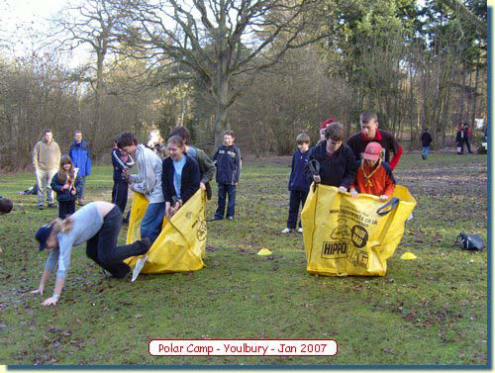
Evening Game: Giant- sack race
Equipment: Two or more cubic metre Jewson's bags (midi bags) A start and finish line about 10 meters apart (depending on age).
Aim: To be the first team over the finish line.
Method:
With 2-4 people in each bag. A race from start to finish by hopping and holding the handles (like a sack race), hop to the finish line.
If anyone falls out they stop, recover their position, and carry on racing. First to the Finish Line wins!

Slide 27
Evening Game: Tennis Ball Madness
Equipment: About 50 or more tennis balls, 5 hoops or containers. One container in the centre, filled with tennis balls.
Teams: Four teams, one team in each corner, about 20feet from the centre, each with their own empty container.
Aim: To fill their container with as many balls as possible in 5 minutes – whistle to start and finish. Strict orders.
Method: Each team starts at their corner; on whistle run to the centre and fetch ONE ball only each trip. Read them the following:
a) Only ONE ball may be carried to your corner each time.
b) Balls must NOT be thrown, but put down in your corner.
c) Any balls falling out of your container don’t count.
d) You may NOT hinder an opponent.
e) You are not allowed to move the containers.
f) You may not guard your own corner.
g) You can steal from any corner you like.
Cheating: Cheats will be disqualified and their balls returned to the centre.

Slide 28
NASA
You are a member of a space crew originally scheduled to rendezvous with a mother ship on the lighted surface of the moon. However, due to mechanical difficulties, your ship was forced to land at a spot some 200 miles from the rendezvous point. During re- entry and landing, much of the equipment aboard was damaged and, since survival depends on reaching the mother ship, the most critical items available must be chosen for the 200-mile trip. Below are listed the 15 items left intact and undamaged after landing. Your task is to rank order them in terms of their importance for your crew in allowing them to reach the rendezvous point. Place the number 1 by the most important item, the number 2 by the second most important, and so on through number 15 for the least important.

Slide 29
NASA
_______ Box of matches _______
_______ Food concentrate _______
_______ 50 feet of nylon rope _______
_______ Parachute silk _______
_______ Portable heating unit _______
_______ Two .45 calibre pistols _______
_______ One case of dehydrated milk _______
_______ Two 100 lb. tanks of oxygen _______
_______ Stellar map _______
_______ Self-inflating life raft _______
_______ Magnetic compass _______
_______ 5 gallons of water _______
_______ Signal flares _______
_______ First aid kit, including injection needle _______
_______ Solar-powered FM receiver-transmitter _______

Slide 30
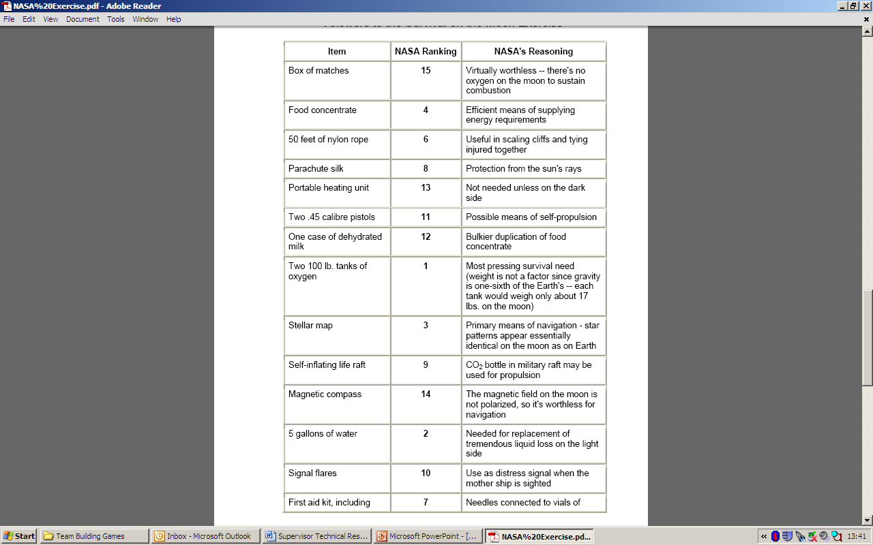
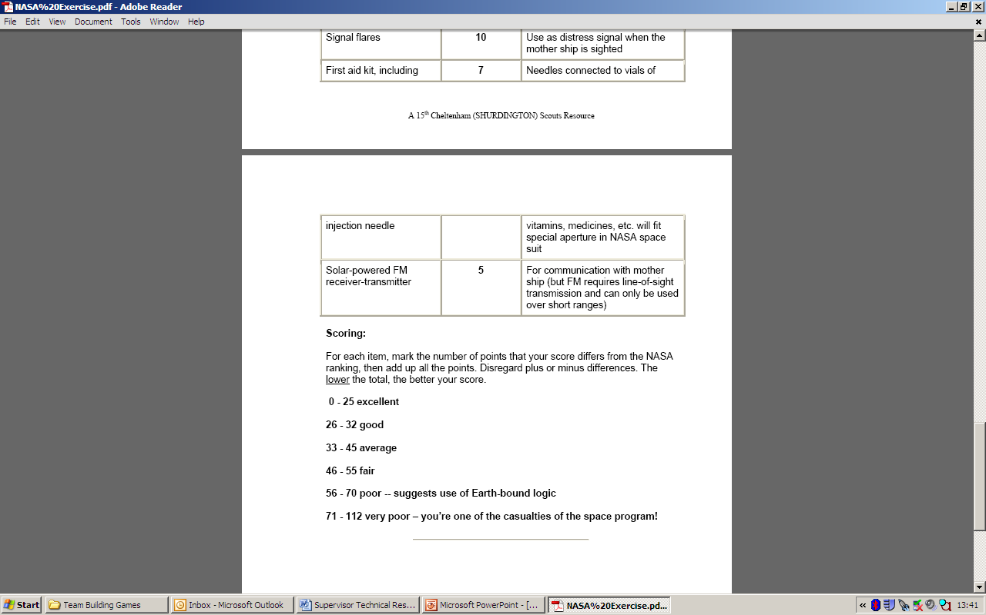
NASA Answers

