Slide 1
Topic 6 B- Countryside, Highway and Water Sports Safety Codes
Access Codes

Slide 2
Countryside Code
This helps us all to respect, protect and enjoy the countryside. The basic principles of this code are:
Be safe – plan ahead and follow any signs
Leave gates and property as you find them
Protect plants and animals, and take your litter home
Keep dogs under close control
Consider other people

Slide 3
Specific to Scotland
As a result of the Land Reform (Scotland) Act of 2003 access in Scotland is on a very much wider basis than in England and Wales.
The Act gives a statutory right to be on, or to cross, all land, inland water and the foreshore. The right may be exercised for recreational purposes or in order to undertake a relevant educational activity and, unlike the CRoW Act of England and Wales, the Act gives a right to undertake activities with a commercial purpose provided that the activities could be undertaken otherwise than commercially or for profit.
This means that those activities most closely associated with open air recreation, such as mountain guiding or instructing, may be undertaken on a commercial basis.
‘Relevant educational activity’ is defined in the Act as an activity which is carried out for the purpose of furthering an understanding of natural or cultural heritage and would include activities undertaken by DofE participants.

Slide 4
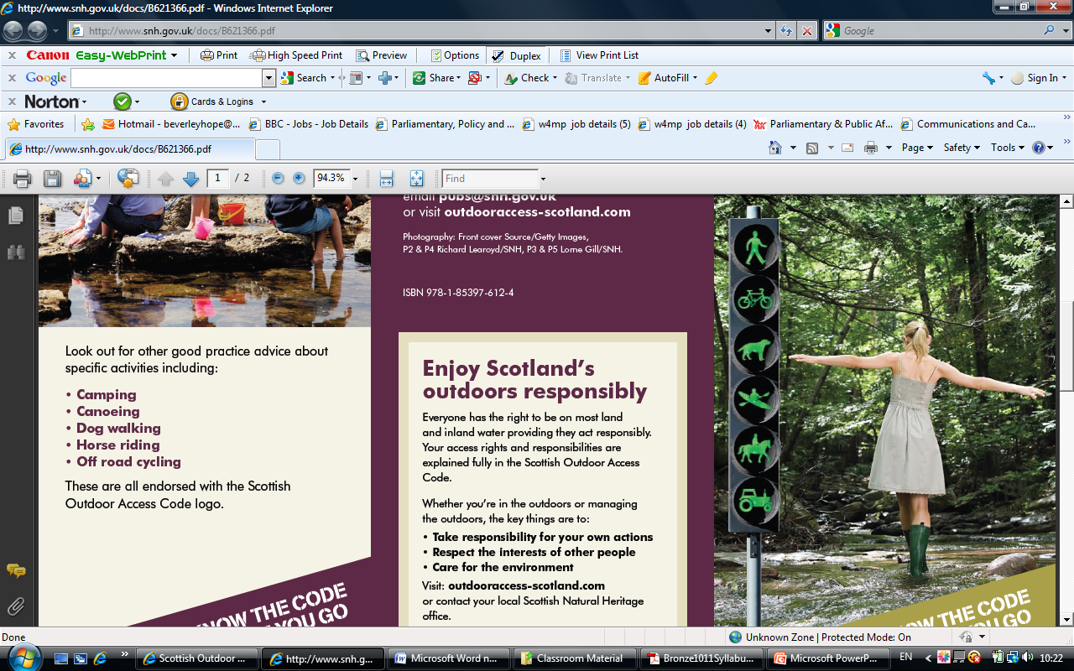
The Scottish Outdoor Access Codes

Slide 5
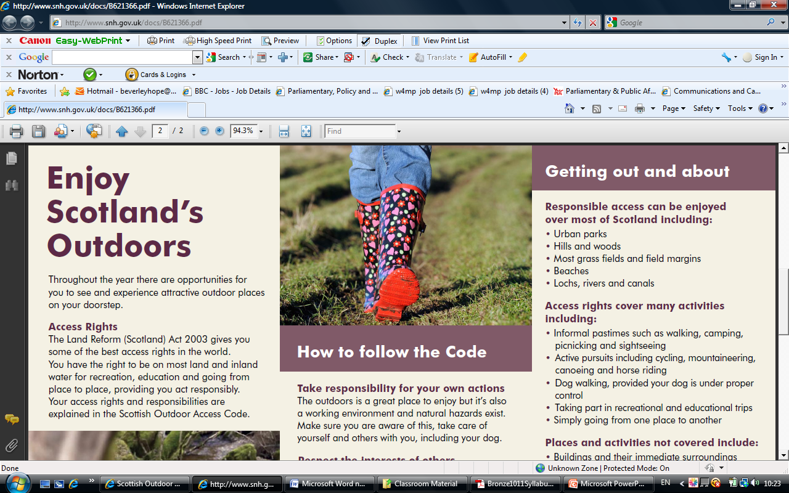
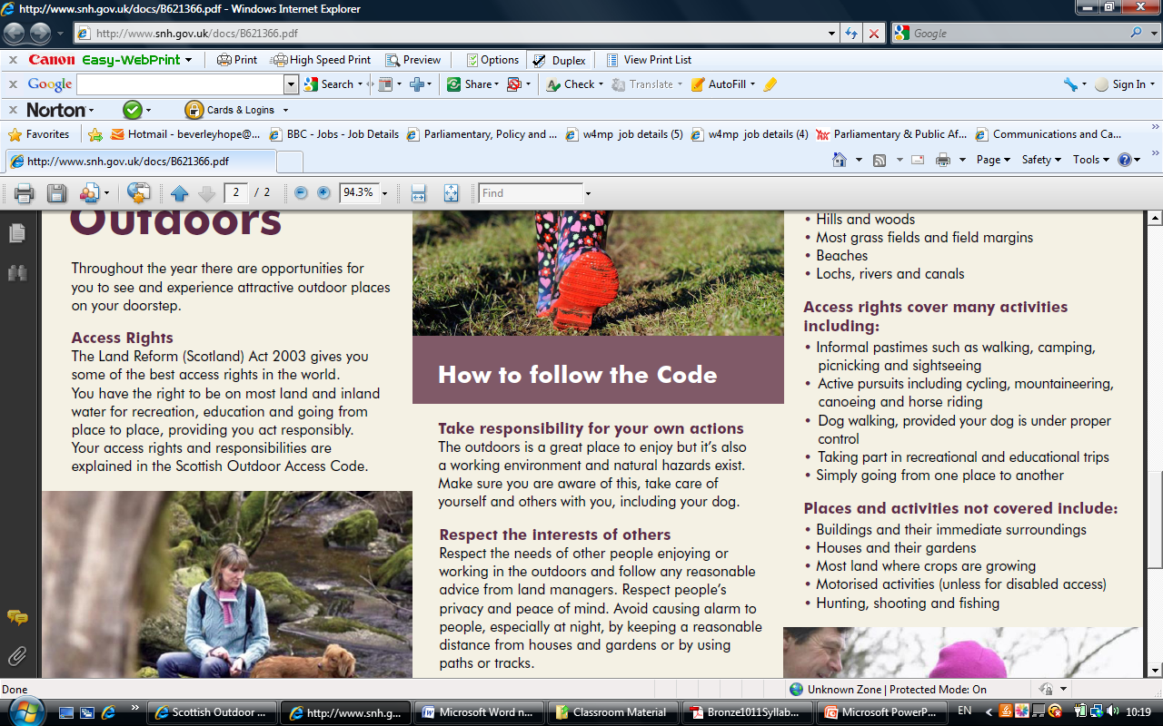
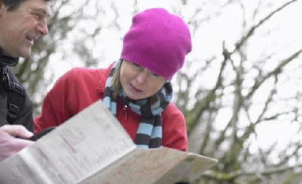

Slide 6
Activities
Activities within the statutory right:
Activities such as walking, cycling, horse riding, rock climbing, hill walking, running, ski-touring, caving, canoeing, swimming, rowing, windsurfing, sailing, diving and air sports.
Pastimes such as watching wildlife, sightseeing, photography, and enjoying historical sights.
Family and social activities.
Overnight camping and wild camping.
Excluded activities
Access rights do not extend to:
Hunting, shooting and fishing.
Use of a motorised vehicle or vessel except when used for disabled people.
Anyone with a dog which is not under proper control.
Taking away anything from the land for a commercial purpose.

Slide 7
Key Principles
Respect the interests of others. Respect the needs of other people enjoying or working in the outdoors and follow any reasonable advice form land owners. Respect other’s privacy and peace of mind. Avoid causing alarm to people, especially at night, by keeping a reasonable distance from houses and gardens or by using paths or tracks.
Take Responsibility for your own actions. The outdoors is a great place to enjoy but it’s also a working environment and natural hazards exist. Make sure that you are aware of this, take care of yourself and others with you including your dog.
Care for the Environment. Do not do any damage to nature, pulling branches of trees for example or littering. Leave things as you find them and do not disturb animals.

Slide 8
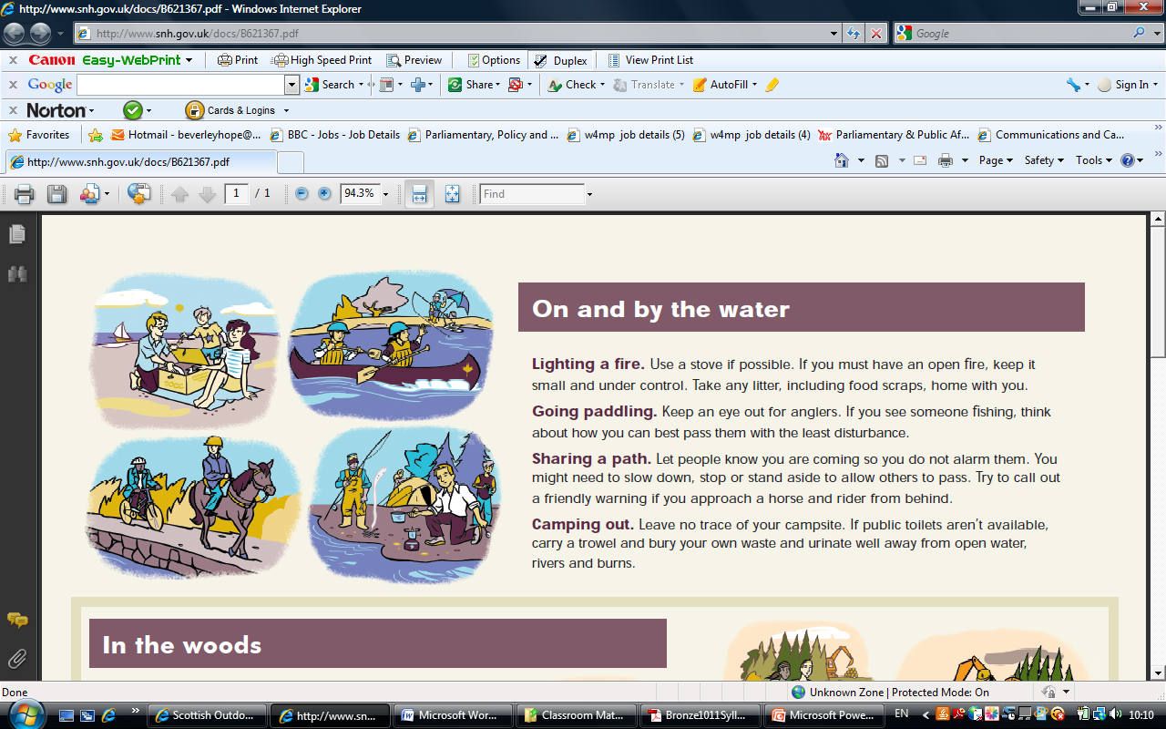

Slide 9
Activity
Hand out Posters and ask groups to select good and bad examples…

Slide 10
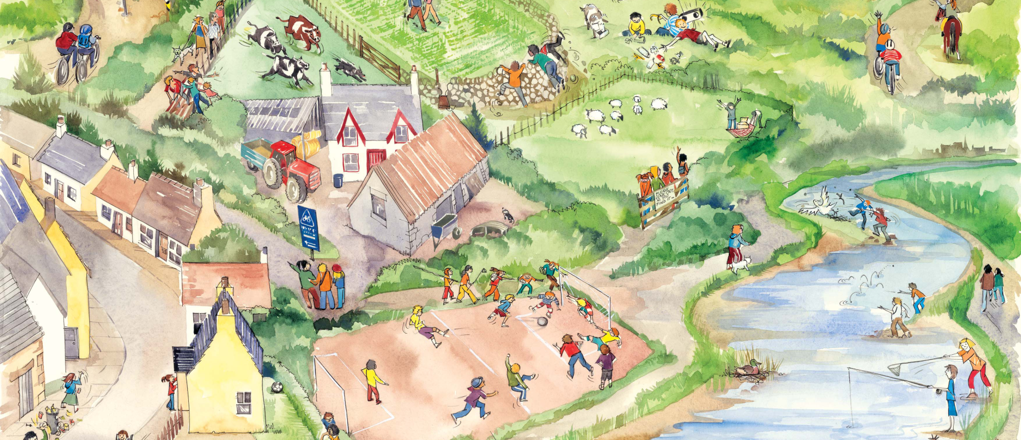
Poster 1

Slide 11
Poster 2

Slide 12
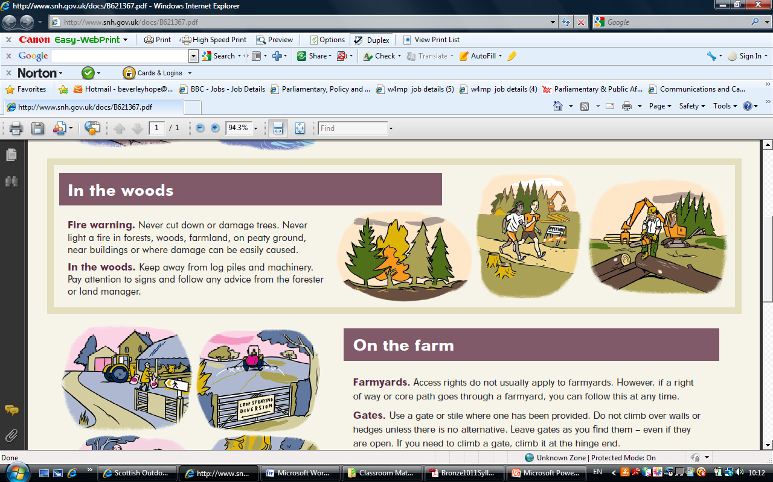
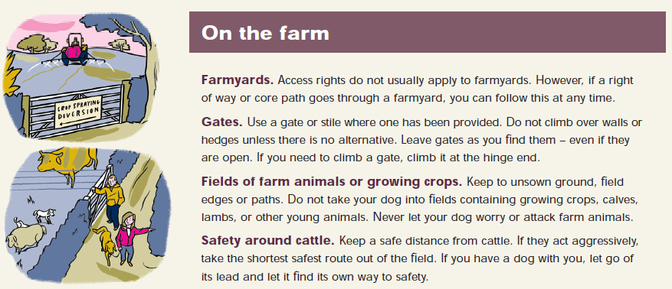

Slide 13
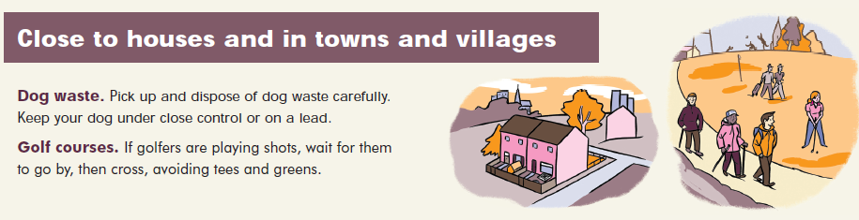
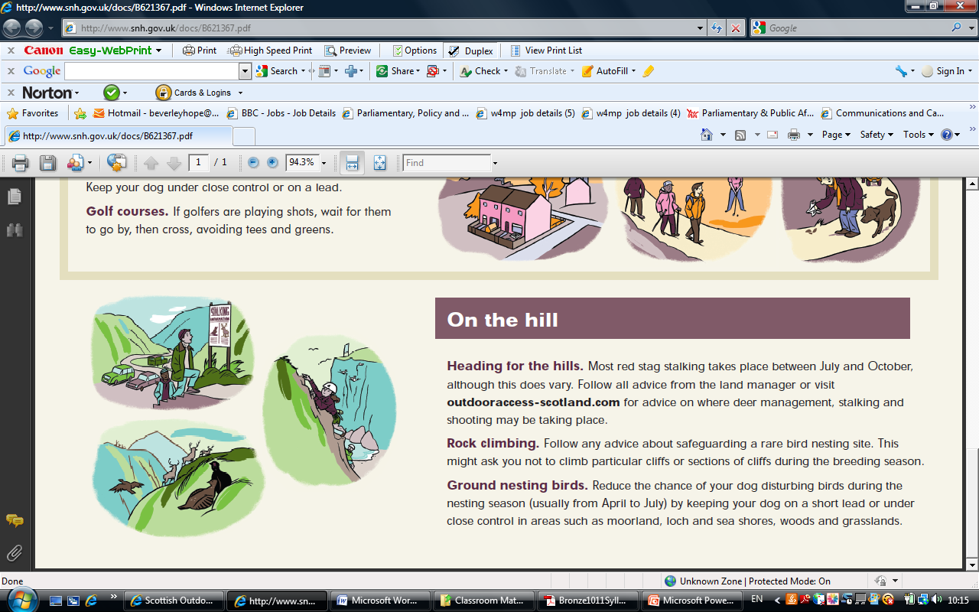

Slide 14
Discussion: Is there anywhere that you think that your access rights don’t apply?

Slide 15
Access codes do not apply in
Houses, gardens, non residential buildings
Crop land
School land
Sport and playing fields
Golf courses (but you can cross)
Airfields, Railways, telecommunication sites, military bases, quarries
Visitor attractions that charge
Access rights do not extend if:
committing an offense, breaching peace, allowing dog to worry livestock, dropping litter, polluting water
hunting, shooting and fishing
motorised recreation or passage (unless by person with disability)
anyone responsible for dog not properly under control
taking anything away from land for commercial use
If you are breaking the law.

Slide 16
Local Access Forum
Local Access Forums: Group of representatives with different interests in access coming together to agree how to develop, manage and promote access locally. Generally the local access forum should include representatives from:
public agencies (local enterprise, natural heritage, forestry commission)
Land managers
Users
Community Interests (community councils)
Two broad functions: to advise on access rights, rights of way and the development of a core path plan and to offer assistance in disputes and about access rights, rights of way, core path planning and the use of core paths.
Brainstorm with the group the potential conflict situations that a forum may be asked to help to resolve.

Slide 17
Activity
Split into groups of 4-8. you will be given a character card for the person that you will represent in the local access forum.
You will also be given some conflicts to work through as a group. Afterwards we will all discuss the solutions that each group have come up with.
Suggestions
Use the Code to make some signs (visit www.outdooraccess-scotland.com for signage guidance and templates for land managers)
Hold a meeting with....
Find money for.... (signs, self closing gates, way markers, path works, hedges, e.g.)
Create a temporary route (think about where this might go and anything you might need to take into consideration)
Ask the local Access Officer/Ranger service to help with....
Consult other groups within the community in order to....
Provide an alternative route or access point for....

Slide 18
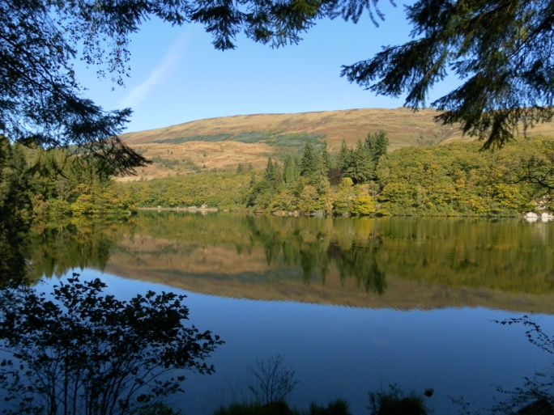
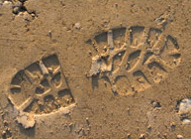
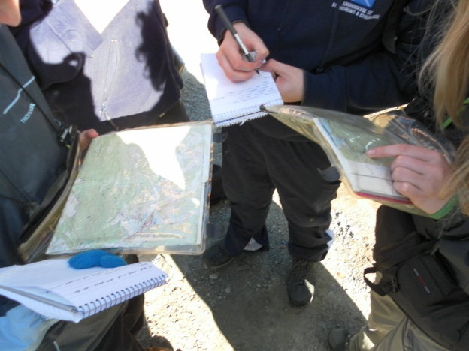
Taking nothing but pictures, Leave nothing but footprints, Kill nothing but time.

