Slide 1
Topic 5 C- Food and Cooking
Expedition Food

Slide 2
Expedition Food
Points to consider when menu planning:
Quick & easy to cook!
Filling & nourishing!
Light to carry (avoid tins!)
Easy to pack & can deal with rough handling.
Avoid food that will go off easily! You won’t have a fridge.

Slide 3
Points to consider pre-expedition:
Make sure you KNOW how to cook your food!
Make sure you have ENOUGH food!
Use your mug as a measuring device – mark the mug to indicate volume. Use a 500ml water bottle as a guide.

Slide 4
Bronze Food Ideas
Day One:
Lunch: Primula cheese; cheese strings; dairylea; pita bread; crackers; crisps; dried fruit; malt loaf; nutrigrain bars (or equivalent).
Dinner: Noodles (NOT pot noodles); pasta & sauce; frankfurters; any dehydrated meals.
Day Two:
Breakfast: Porridge (with water); frankfurters; noodles. HOT DRINK is a must! It can be cold first thing in the morning.
Lunch: As above.
Plus:
Puddings: Custard; hot crunch puddings; fruit cake; malt loaf; dried fruit; chocolate.
Snacks: Biscuits; raw jelly; chocolate; dried fruit; mint cake; sweets.
Drinks: Hot chocolate (water based); tea or coffee with dried milk; soup.
Stoves are shared one between two so you may want to organise your dinner & breakfast in pairs.
REMEMBER: You will be working hard for 2 days so will need plenty of energy.
Your assessors will check your menus with you on competency & practice expeditions & let you know of any problems so you can get it right on your qualifying!

Slide 5
Activity
In Groups using flip chart paper you will be given a heading either: Breakfast, Lunch, Dinner or Snacks.
You have 2 minutes to come up with ideas of food that might be good to eat on expedition in this category

Slide 6
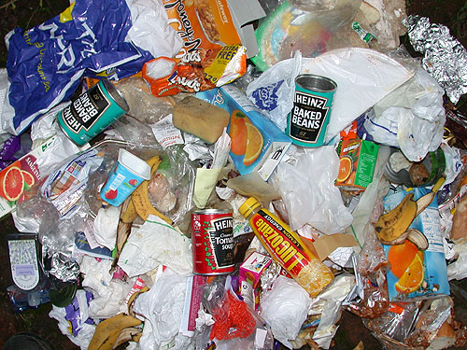
Think Packaging
“Think Packaging” “Think Rubbish”
Using samples of food brought in discuss the good and bad points of each type of packaging

Slide 7
Activity : How Heavy?
Using Examples of Food and a set of scales play guess the weight!
Interesting fact 1ml/1cm³ of water weighs 1g so what would 1 litre of water weigh?

Slide 8
More Ideas: Main Meals
As a base (carbohydrates) :
Any kind of dried Pasta in Sauce.
Couscous [a type of pasta] – cooks incredibly quickly.
Noodles – good filler but definitely need something adding to them
Uncle Bens Microwaveable Fried Rice – no, there won't be a microwave at your campsite but it is pre-cooked and will heat up in a very short time in a pan or mess
tin.
Dried mashed potato mix (eg smash). Very light and produces ALOT of mash for a relatively small amount of packet mix.
Then add :
Pitta Bread, Naan Bread, Fajitas - already squashed so won't come to any harm in you rucksack and can be warmed up on top of a pan lid whilst cooking the base meal.
Uncle Bens Chinese sauces – preferably dried type in packets
Any other dried sauce in a packet!!
Vegetable/Chicken/Beef Stock cubes – to add flavour
Pepperami – all sealed up, bomb proof! Slice and add.
Dried Mushrooms/Onions – weigh nothing but plump up and add a lot of flavour to your dish, remember to add a bit of extra water for them to re-hydrate.
Pesto and Herbs & Spices - can be packed into an empty film canister.
Sun dried tomatoes

Slide 9
More Ideas: Dessert
Flapjack – why not make your own
Fruit Cake, better still Christmas cake with icing on!
Malt Loaf
Crunchy Cereal bars or crunchy cereal / mini weetabix type stuff
Jelly
Instant Custard & Dried banana
Jamaica ginger/chocolate/golden syrup cake and custard - very fast and delicious
Dried apple rings with instant custard – fantastic, but remember to make the custard runny so that the apple can reconstitute.
Angel Delight
Dried fruit – tropical is a particular favourite, also apricot and mango.
Nuts/Trail Mix/Bombay Mix/Seed mix – make sure no-one is allergic to nuts though!

Slide 10
More ideas : Breakfast
BREAKFASTS
Having something hot for breakfast makes a very positive start to the day, even if its just a
cup of tea with your cereal bars!
· Porridge [ready brek] – pre mix this with milk powder and sugar to taste, add some
dried fruit for extra interest.
· Cereal bars
· Jordans Crunchy Cereal or other kind of cereal which won't squash – pre mix with
milk powder
· Wayfarer breakfast meal (eg potato and beans with pitta bread)

Slide 11
Activity
In your groups decide whether you are cooking to cook as an expedition team, or in smaller stove groups?
What will you eat, what do you need on your shopping list?

