Slide 1
Topic 5 B- Food and Cooking
Food and Nutrition

Slide 2
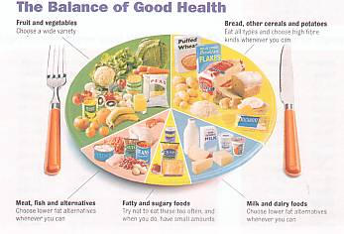
Food and Nutrition

Slide 3
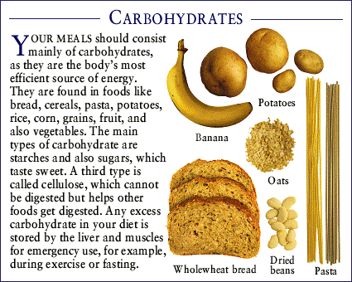
Carbohydrates
Carbs are your bodies major sources of energy for growth, body maintenance and activity.

Slide 4
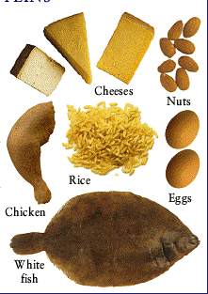
Protein
Protein helps your body to build cell’s and tissues and to produce certain hormones and other active chemicals.

Slide 5
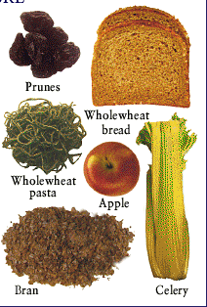
Fibre
Fibre keeps your faeces soft and bulky, preventing constipation and some disorders in the intestine

Slide 6
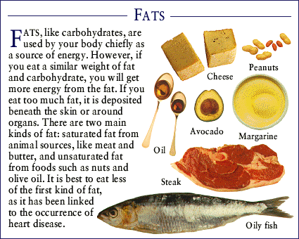
Fat
Fat provides energy and a layer of fatty tissue beneath the skin to conserve body heat

Slide 7
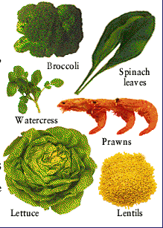
Minerals
Minerals help build your bones and control fluid balances, body responses and gland secretions

Slide 8
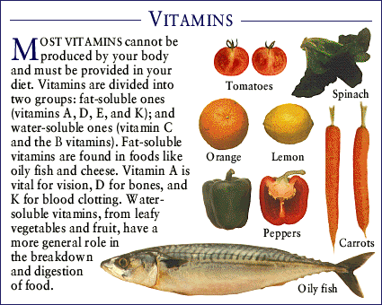
Vitamins
Vitamins regulate chemical processes that take place in your body and help convert fat into energy.

Slide 9
Water
Water is a means of transport for nutrients, waste and hormones. It also controls the distribution of body salts.

Slide 10
Understanding Calories
What are calories?
Are they good are they bad?

Slide 11
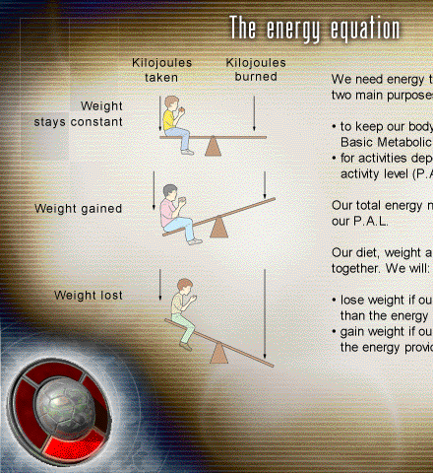
Calories
Calories are a necessity!
People associate calories with putting on weight. However we need energy to make our bodies work.
Our diet, weight and energy needs are all linked together. We will loose weight if our energy needs are greater than the energy provided by our diet.
We will gain weight if our energy needs are less than the energy provided by our diet.

Slide 12
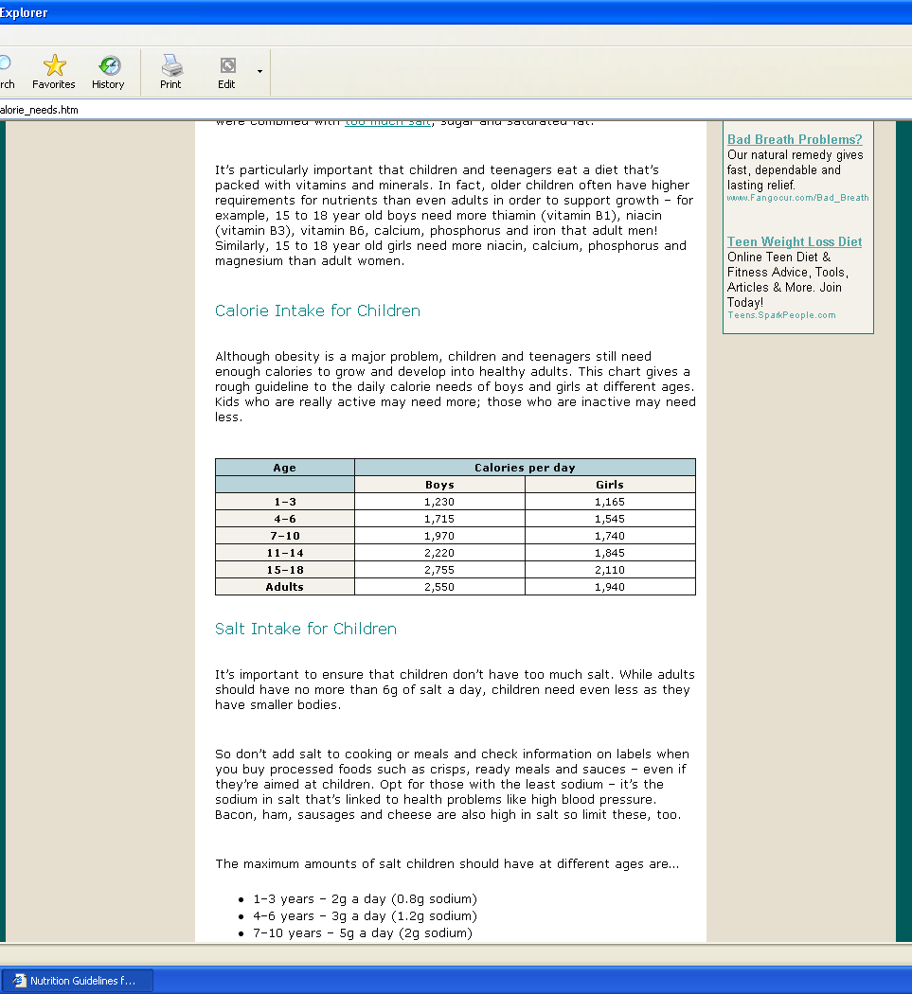
Standard Day

Slide 13
But then with exercise you must make further considerations!

Slide 14
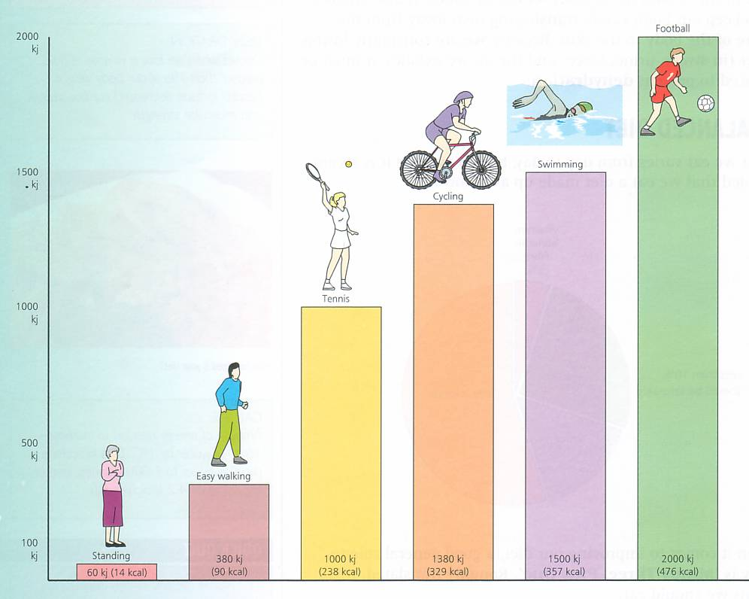

Slide 15
Energy
When hiking this can increase to 400-600 more calories extra per hour.
So eating the right food is important.

