Slide 1
Topic 3 G- Navigation
Compass

Slide 2
Compass
What is a compass?
What does it do?

Slide 3
Compass
The first compass used in history was recorded by the Chinese in 1088 AD. Compasses should only be used when you know and understand a map well! There is no point using a compass on a map if you can’t work out where you are.
The compass operates with a magnetic needle that floats freely on a pivot that points towards magnetic north (an area in Canada more than a thousand miles away from the North Pole).

Slide 4
Compass Activity
Make your own!
Method 1
Hold needle with finger, stroke with 1 pole of permanent magnet in same direction to magnetise.
Cut 2cm piece of paper and push needle through it.
Make a small hole in top of paper and carefully tie a length of cotton through the hole.
Tie paper and needle to pencil and rest on top of a jam jar, where the needle point is north.
Method 2
Magnetise needle, rest on piece of floating cork in saucer of water.
Needle will point to North.

Slide 5
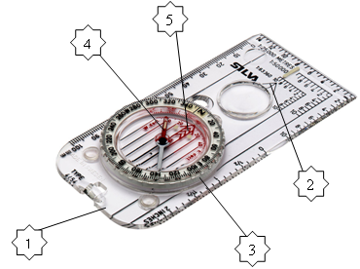
Compass Parts
Base Plate- Clear base of the compass, marked with measurements and also a direction of travel arrow.
Direction of Travel Arrow- follow when shooting a bearing.
Compass Housing/ Bevel- Round disc which marks direction with 360 degrees marked around it. Houses the orienteering arrow and the magnetic needle.
Magnetic Needle, Red= North and White= South.
Orienteering arrow- drawn on the plastic in the compass housing, the lines that are parallel to this are called the orienteering lines, red hatching.
Romer Scale
6

Slide 6
Activity
You will be given a compass
In your groups do a quick sketch of it and name all of the parts

Slide 7
Compass Care
Avoid dropping the compass, swinging it around or exposing to excessive heat - the result of which can be bubbles and damage to the Magnetic Needle. It should also be stored away from items which are magnetic (including other compasses) and metals such as Iron and Steel.

Slide 8
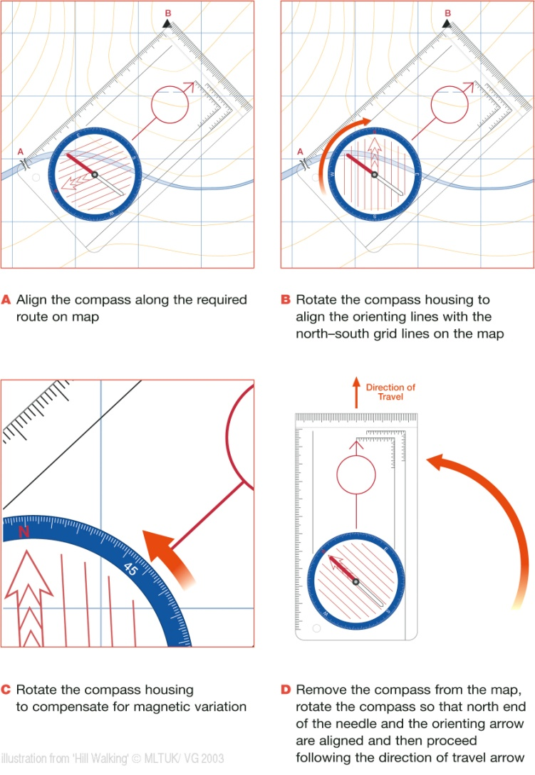
Compass Bearings

Slide 9
Activity
Carry out the Compass Bearing Introduction Exercise.

Slide 10
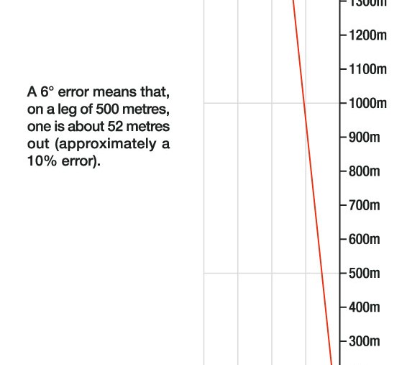
Magnetic Variation
The needle on a compass aligns itself to the magnetic field of the earth, which is south of the North Pole. This direction that the compass needle points is magnetic north. The more you know about how a compass works the better you will be with it. The lines of the earths magnetic field does not run in a regular pattern due to local magnetic forces and the magnetic pole is always on the move.
Variation size in degrees depends on where you are. It is specified on the map however this must be checked before leaving home as the variation can change significantly. It is important to adjust for magnetic variation so that both map and compass speak the same language. To make them equal you must either add or subtract depending on if you have an easterly or westerly declination. It also depends on if you are converting a map bearing to a compass bearing or converting a compass bearing to a map bearing. If the compass needle points west of true north, this offset is designated as west declination. The world standard, including in the southern hemisphere, is in reference to the magnetic north (MN) declination.

Slide 11
Magnetic Variation
The rule at present is that if you are taking a bearing from the map and going to follow that bearing on the ground then you add magnetic variation by turning the compass housing anti- clockwise. If you are working from the ground to the map then you delete it, by turning the compass housing clockwise. The easy way you remember this is that the map is a small thing and the earth is a big thing so you have to add it (make the bearing bigger) and when going from a small thing to a big thing.

Slide 12
The influence of ferrous objects and electromagnetic fields
Remember that as the name would suggest magnetic compasses have magnets inside them and so can be affected by iron and steel objects so when you need to take an accurate reading, make sure the compass is not placed near pocket knives, belt buckles, railway tracks, overhead power lines etc.
Earths core is molten because of the heat from ongoing radioactive decay. Convection currents flowing in the outer core generate the magnetic field. The poles of the magnetic field do not correspond with the geographic poles with the magnetic north pole being roughly 1000km from the true (geographic) north pole.

Slide 13
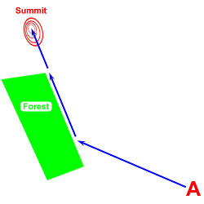
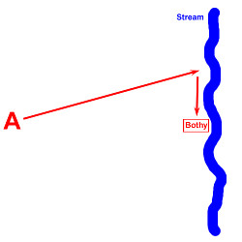
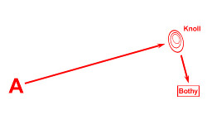
Compass Strategies
'Handrailing' can be used when there is a linear feature that will take us towards the target. A handrail could include paths, streams, ridges, walls etc. In the example shown the task is to go from point A to the summit. The edge of the forest is a linear feature which can be followed towards the summit.
Aiming Off is used when the target lies on a linear feature such as a ridge,The bothy is situated at the side of a prominent stream. If we head directly for the bothy but don't hit it straight on then we won't know which way to turn to locate the bothy. By 'aiming off' to hit the stream to one side of the bothy we will know which way to turn.
An attack point is a feature that is relatively close to your target but is more significant and easier to find. n the example shown the task is to go from point A to the bothy. Locate the knoll first and then head in a new direction to the bothy. The knoll is the attack point in this example.

