Slide 1
Topic 3 E- Navigation
Contours

Slide 2
What is the biggest difference, to what is on a map and what is on the ground?

Slide 3
A Map is 2D and the world is 3D.
In order to show height or depth on a map a system called contours is used.
Look at a map, what do you notice about the contour lines? Make a note of these things and we will come back to this.

Slide 4
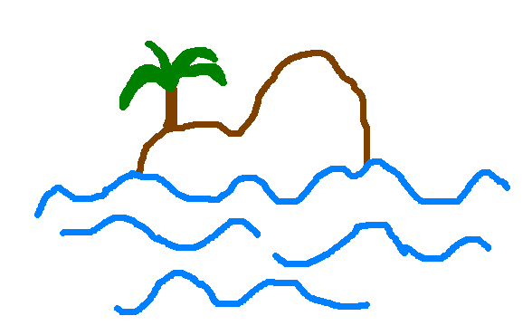
Activity
Draw an island, from the side you can put anything on it that you like.

Slide 5
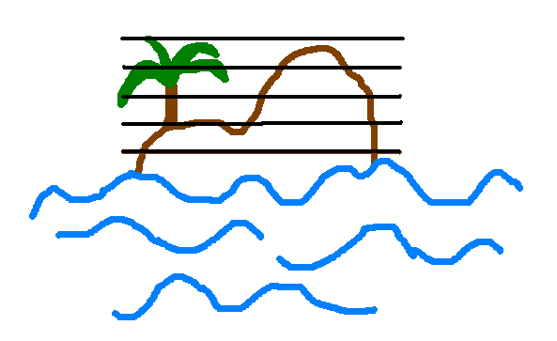
Contour Lines
50
40
30
20
10
Can you see the lines at 10 metres intervals?
Can you see that sea level would be 0m?
Now what would this look like from above?

Slide 6

Contour Lines
20
30
40
20
10
Now can you draw what yours would look like from above?

Slide 7
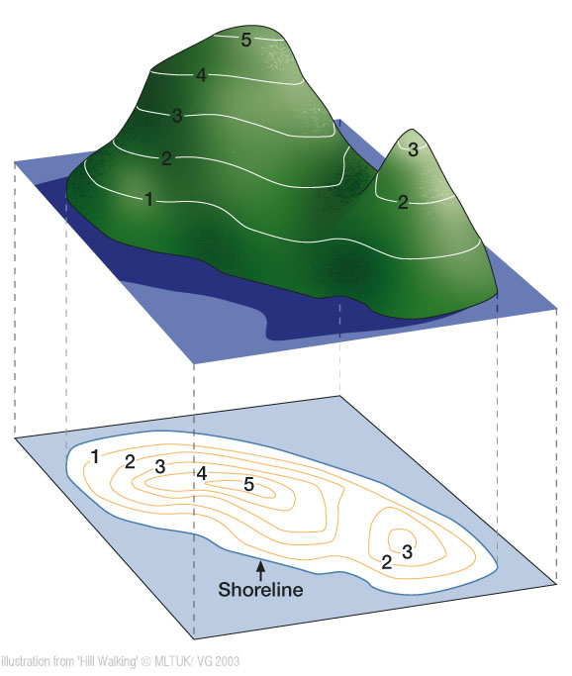

Slide 8
Contour Lines
Why do you think contour lines or your ability to read them are so important?

Slide 9
Contour Lines
They are the only things that will not change.
Water can dry up or flood
Trees can grow or be cut down
And buildings can be pulled down or built
Contour lines join points of equal height.
On ordinance survey maps they are always brown.
Check the interval between the contour lines in the margin on the map, but on the maps that we will be using it will be ten metres.
Contour Line numbers always read uphill

Slide 10
Contour Interpretation
300m
What do you notice about the lines on the steeper slope?
250m
200m
150m
100m

Slide 11
What is the steepest point on the map?
200
150
100
50

Slide 12
Steepest slope – contour lines are closest together
200
150
100
50

Slide 13
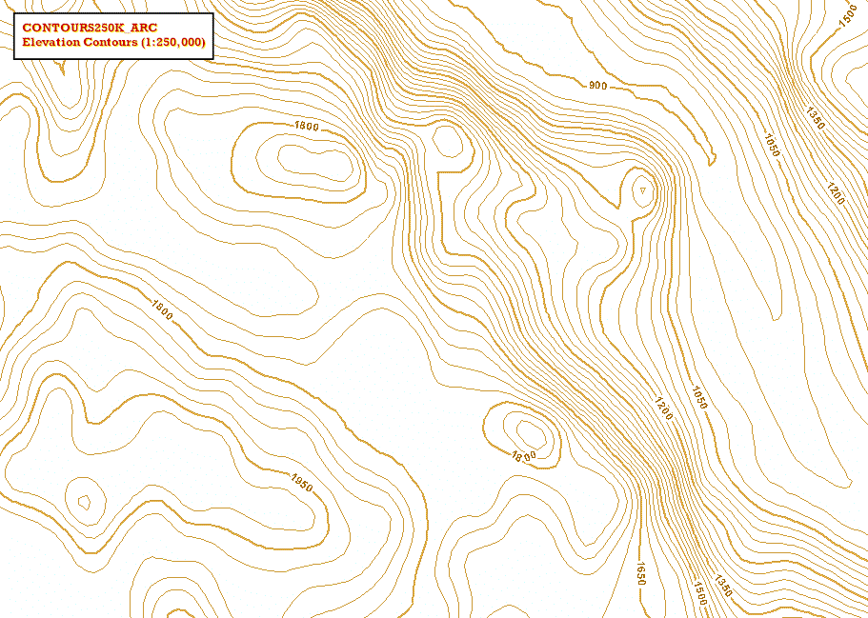
Contour Interpretation Activity
Study some different maps and look at flatter area’s and steeper needs.
Steep slopes
Darker shade contours are index contours
Area that is flatter with only a gentle slope

Slide 14
Interpreting Contours

Slide 15
Contour Challenge
You will be given a contour worksheet try and match up the contours!

Slide 16
Contour Features
You can spot other features by the shape and pattern of the contours.
Can you see any of the following on the map?
Ridge
Summit
Steep Slope
Saddle in between two summits
Gentle Slope
River
Valley
Gulley

Slide 17
Activity
Form into groups, draw a line on a map to show the route to be travelled, it can be anything that you like.
Now section this route into a section per person in your group. i.e if there are 5 people in your group your route shout have five sections.
Label them and then describe them in turn.

Slide 18
Activity
Why should you plan your route?
In pairs, as many reasons as you can come up with as to why you should plan a route?
As soon as you have finished, stand up.

Slide 19
Why plan a route?
To have an idea of where you are going
To check it is within your groups capabilities
Safety….leave a copy at your centre or camp so people know where you are going
Timing & distance verses daylight hours

Slide 20
How do we work out timing?
Naismiths Rule
4 km per hour + 1 minute for every contour up (this can also apply downhill).
You adjust this timing to suit your group.
With a full pack over rough terrain you may only walk at 3 Km per hour

Slide 21
How long does it take to walk 1KM if you are traveling at…
3km/h
4km/h
5km/h

