Slide 1
Topic 3 D- Navigation
Grid References

Slide 2
Does Anyone know how you would tell someone your exact position on a map?

Slide 3
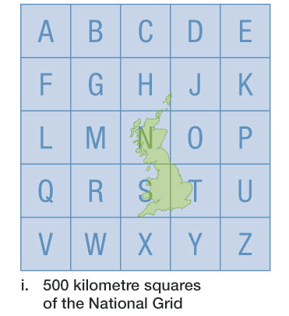
The National Grid
What square is Glasgow in?

Slide 4
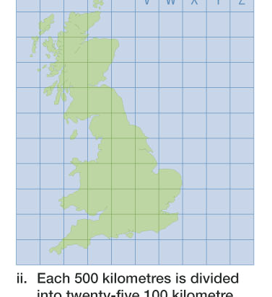

Slide 5
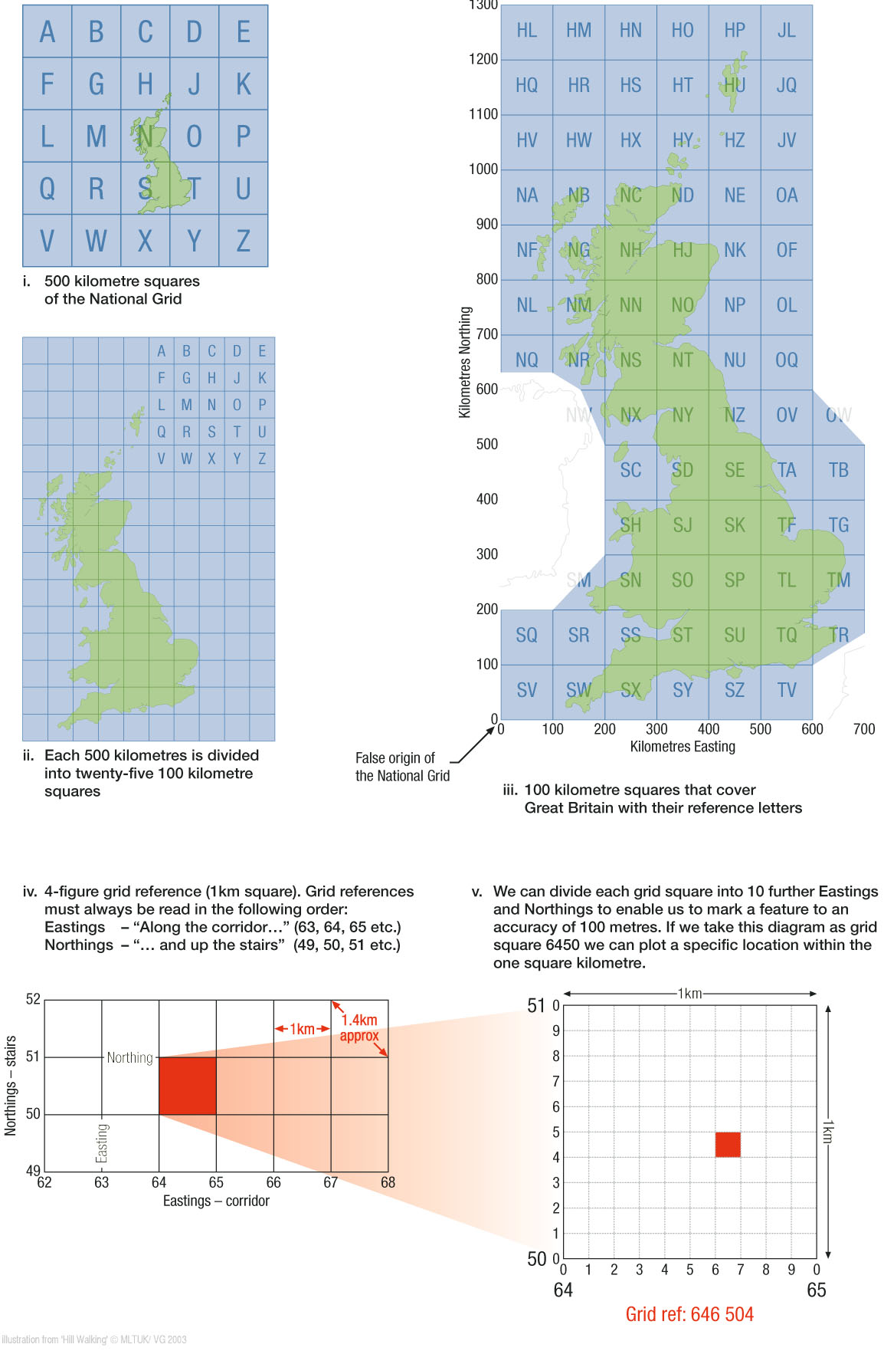

Slide 8
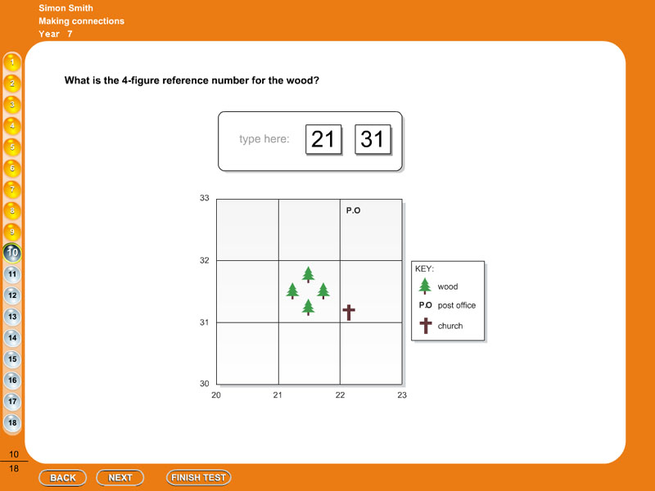
Grid References
Lets Look at the Church in this map.
Remember ‘along the corridor and then up the stairs’ or graphs in maths is always (x co-ordinates, y co-ordinates)
First three numbers are along
Second three numbers are up
221 311

Slide 9
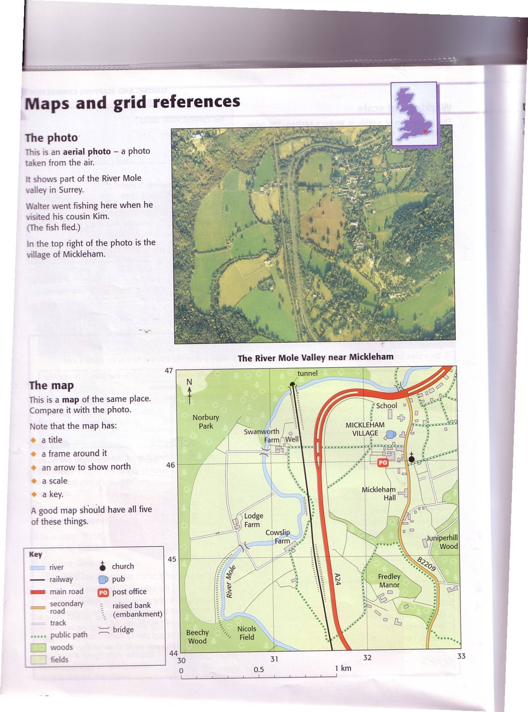
Grid References
What is the 6 figure grid reference for the church?

Slide 10
Grid References
What is the grid reference of Lodge Farm?

Slide 11
Grid References
What is the grid reference of the school?

Slide 12
Grid References
What is the grid reference of the school?

Slide 13
Grid Reference
What is at 6 figure grid reference 325 456?

Slide 14
Activity
Using any map… split into pairs. Name one A and one B. Person A is going to make up some grid references for objects on the map. Now person B has to find them. Swap over.

Slide 15
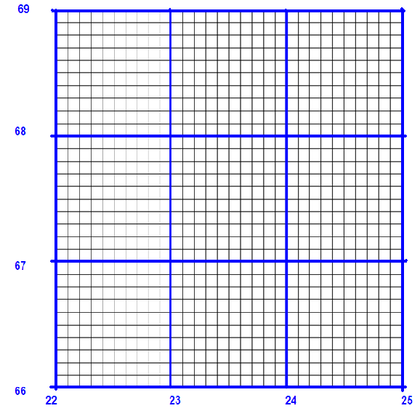
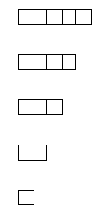
Battleships
Spilt into pairs, each person will be given two sheets as shown. On one sheet put on your own battleship, use the other one to try and find out where your components are.
Everyone has the following battleships:

Slide 16
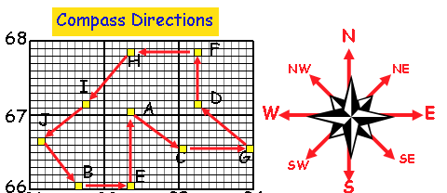
Give the Grid Reference for each Letter
State the cardinal or intercardinal directions from point to point… A-B-C-D-E-F-G-H-I-J

Slide 17
Activity
On a laminated map draw a short route using a non permanent marker.
Put participants into groups, and ask them to write a route plan for this route. They can do it using just gird references and cardinal and intercardinal points.

