Slide 1
Topic 3 C- Navigation
Map Symbols, Direction and Scale

Slide 2
Directions
Instead of using Left and Right, we need to be able to explain more directions when we navigate.
What terms can we use for this?

Slide 3
Cardinal Points
North
West
East
South

Slide 4
So if you know what Cardinal Points are can you work out what intercardinal points are?
The clue is in the word…Inter- Cardinal

Slide 5
Cardinal and Intercardinal Points
A
H
B
G
C
D
F
E

Slide 6
Cardinal and Intercardinal Bearings
North 0-360°
_______
45 °
_________
315°
_______
____
West
____
South East
_____
________
____
South
180°

Slide 7
Scale
1:50,000: 1cm on the map is 50,000 cm on the ground (500 m). So information in 500m on the ground is compacted into 1 cm on the map. (2cm=1km)
1:25,000: 1cm on the map is 25,000 cm on the ground (250m) so information in 250m on the ground is compacted into 1cm on the map. (4cm= 1km)

Slide 8
Scale Activity
Take two maps of the same area but different scale. Photocopy and laminate then cut out into sections. Ask your group whether in teams or individuals to pair up the places which are the same.

Slide 9
Activity
Split into two teams, create a map of your school, now create signs to put in locations on your map. You are making an orienteering challenge for the there group. The signs could have a letter on it that the team cannot find out unless they visit that sign. The letters from all the signs could be used to make a word. Each team will swap maps and do the challenge. Fastest team is the winner.

Slide 10
Map Symbols
Maps hold vast quantities of information so to save space, symbols are used as they take up less space than words.
Symbols may be simple drawings, letters, shortened words or coloured shapes or areas.

Slide 11
How can we use map symbols
All OS maps have a key to tell you what the symbols mean, so you do not have to learn them all off by heart. However if your map is in the map case you do not want to have to take it out every two seconds.

Slide 12
Map Symbols
Some map symbols can tell you more than just the location of a feature.
For example the following symbols all indicate churches, each one will tell you a little bit about what the church looks like.
Can you find out the difference between each one?

Slide 13
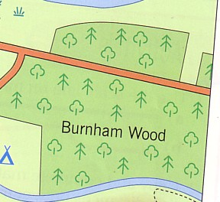
Map Symbols
Areas of woodland too will tell you what type of trees are to be found.
Below is the symbol for a mixed woodland, but the trees could be shown as either just coniferous or just deciduous

Slide 14
Symbol Bingo
The Rules:
No False Shouting out Bingo or Line.
Ensure you know what each symbol means
Stand up when you have a line or house.
The first person to stand up attempts the bingo challenge.
You will have to explain what the symbol means.

Slide 15
Your Bingo Card
Draw your own bingo card like so:

Slide 16
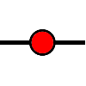














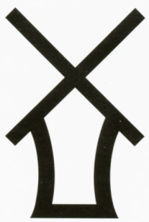






Choose any of the following symbols and draw them on your bingo sheet.

Slide 17
Game 1
The Bingo caller will give you the name for each symbol and you will have to work out what that symbol relates too.
Every time you get a symbol put a cross through it.
When you have a line put your hand up.
When you have full house stand up and say bingo.
Double Check your answers are correct

Slide 18
Game 2
Can you match the following symbol on your card.
If so then you also have to stand up and say what it is.

Slide 28


Slide 31


Slide 32
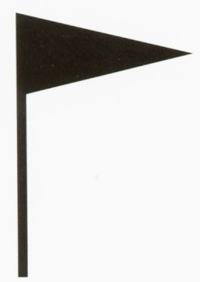

Slide 33


Slide 34


Slide 35


Slide 36
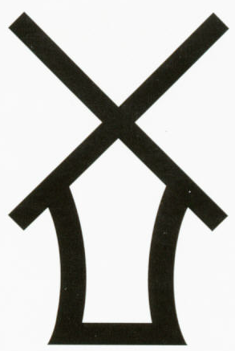

Slide 37


Slide 40


Slide 41
There are more symbol games on the ordinance survey website, which can be found at…
http://www.ordnancesurvey.co.uk/oswebsite/education/teachingresources/

