Slide 1
Topic 3 B- Navigation and Route Planning
Introduction

Slide 2
Resources Required
Sheet Map

Slide 3
Resources Required
Variety of Different Types of Maps (Ordinance Survey 1:20 000 and 1:50 000, Harveys, Orienteering Maps the more the better)
Paper and Coloured Pens/ Pencils

Slide 4
What is a map?
A map is a representation, usually on a flat surface, of the features of an area of the earth, skies or water. Showing them in their respective forms and sizes.

Slide 5
Arial Maps
We will be using political maps, and more specifically they will be Arial Maps created by Ordinance Survey.
An Arial Map is a map from a birds eye view.

Slide 6
Why do we need maps on expedition?

Slide 7
Activity
Pass out different types of maps to all participants. What do these maps have in common?

Slide 8
Map Components
Names of important places & locations
Standard symbols to show key features.
A key or legend to explain the symbols
A grid system of lines to allow you to pin point your location
A scale system to allow you to measure distances.

Slide 9
Activity
Everyone will be given a map piece , see if you can put them together like a jigsaw!
There might be more than one map!

Slide 10
Activity
Draw your route from home to the school. Try to use symbols for objects and create a key.
Remember everything should be created in Arial view (bird’s eye)

Slide 11
Activity
Set a north point of the classroom.
In pairs, create a map of the classroom. Draw a starting point and finishing point on this map and a route.
Each member of the pair should try and follow the route prepared by there partner.

Slide 12
Discussion
What problems did you face?

Slide 13
Setting the Map Intro Activity
Pencil Case
Paper
Cup
N
Place some objects on your table and draw them out. It might look something like this. Use classroom North. What happens when you turn your picture around? Does it still match the objects in the real world?

Slide 14
Activity
Now take the map of your classroom and navigate the route your partner gave you again, was it easier now that you keep your map set?

Slide 15
Classroom Activity
N
Individually draw out a map of the classroom, the teacher will place cards at each point and tell you where they are so that you can draw them on your map. Phrases like Point 1 is placed at the South East corner of the desk most south east in the room. You will be able to see this happening to help you position them on your map.

Slide 16
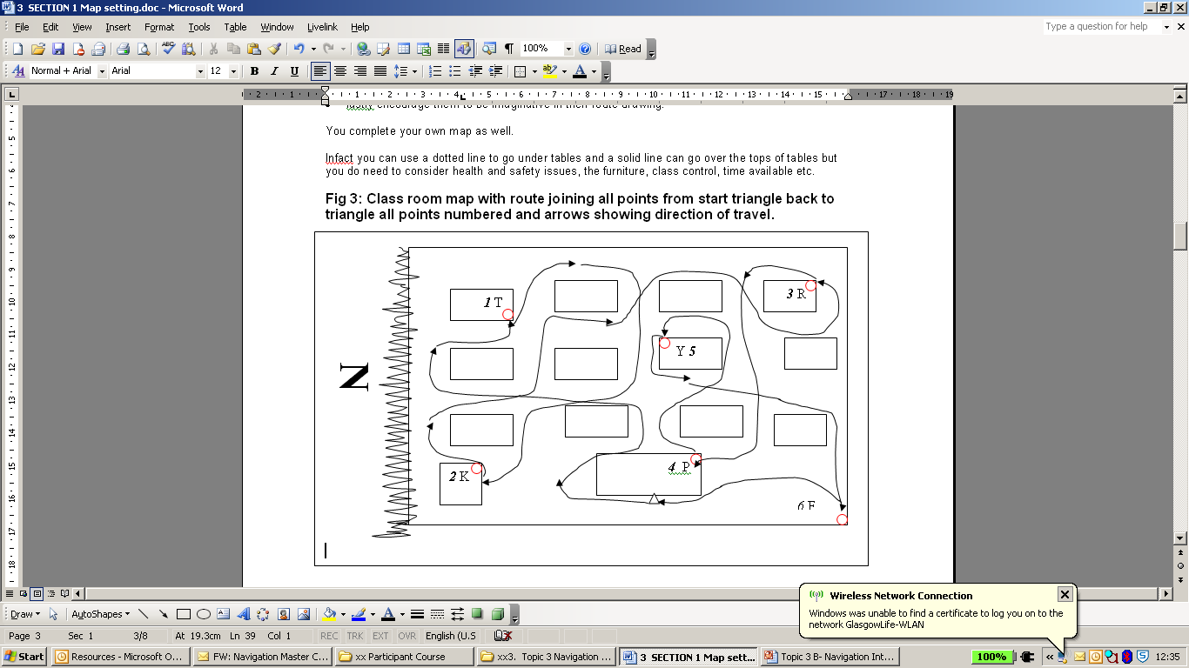
Classroom Activity
Now using your map, draw a route on it to get from your seat around all the markers and back to your seat again.
Now you will follow your map, each marker will have a letter, number or symbol for you to collect when you get there, write this on your map

Slide 17
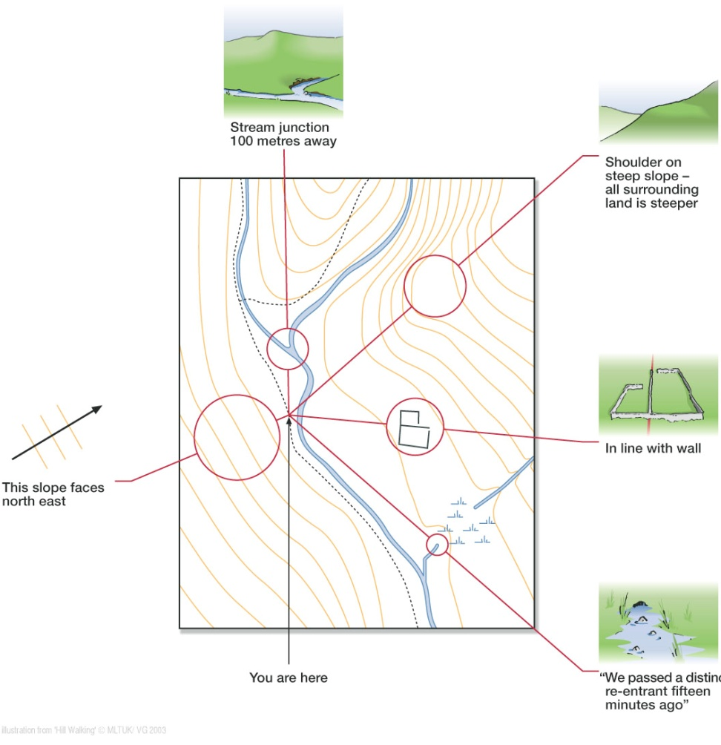
Setting the map
In order to use a map for navigation you have to set it. This means aligning the map in the same direction as the ground, so that what is in front of you on the ground is also in front of you on the map:
Using area features work out what general area you are in
Using line features like a road, line up the road with road on the map but check it is correct way around.
Point features, check point features around you to verify you are where you think you are.
Bare in mind that once the map is set, the writing on the map may appear upside down, this is ok. When you are walking, if you change direction it is important to note that it is your body that should move, not the map.

Slide 18
Setting the Map Activity
Set a course of nine cones, this will look like a grid. Arrange an area to be North. Decide on a route from cone to cone with an obvious starting point, you can use as many cones as you like. The aim of this activity is to follow the route which is on the map whilst keeping the map set at all times. Remember the body moves around the map.
To make this harder for some participants: challenge them to do it as fast as they can, give them cones, and get them to make there own route and maps.

Slide 19
Setting the Map Activity Example
North
Remember to keep your Map Set all the way!

